Slide 1

Dark Wolf Hack Our Drone
Closing Remarks

Slide 2





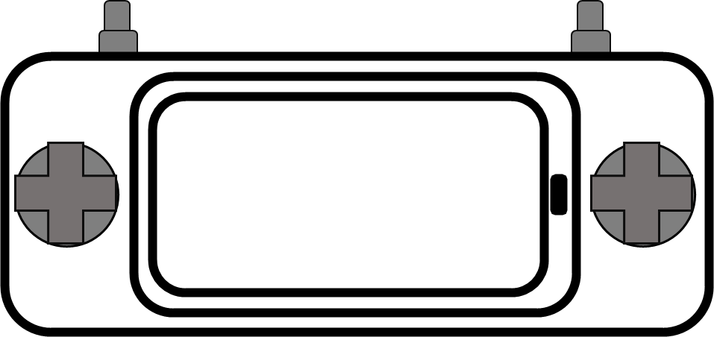

UAS Cybersecurity: The Where
System Decomposition and Interfaces
Hardware
UAV
GCS
Telemetry Radio
RC Radio
Payload
Software
Flight Software / Firmware
Supply Chain
Software Libraries
Sensors
GPS
ADS-B
DroneID
Services
Cloud
GPS
ADS-B
RF
Wifi
Supply Chain
RF
Wifi
Software Libraries

Slide 3
UAS Security: The What
What to Look For
UAV
Vulnerable Services
Vulnerable Bootloader
Unencrypted Firmware
Weak or Default Credentials
GCS
Weak or No Credentials
Authentication Bypass
Comms
Weak or Default Keys / Passphrases
No Encryption
Spoofable Protocols
GPS
ADS-B
RF
Wifi
Supply Chain
RF
Wifi
Software Libraries

Slide 4
UAS Security: The Who
Multi-disciplinary
Operating Systems
Software Applications
Boot-loaders
IoT / Root of Trust
Single Board Computers
Embedded Systems
Mobile Devices
Radio / WiFi / Wireless
Cloud Services
GRC (governance, regulation, compliance)
GPS
ADS-B
RF
Wifi
Supply Chain
RF
Wifi
Software Libraries

Slide 5


THINK LIKE A HACKER
govt funded

